Slide 1


Department of Computer Science and Engineering
PREDICTION OF HATE SPEECH CLASSIFICATION BY USING SUPERVISED MACHINE LEARNING WITH NLP
ASWINI T [211419104031]
HEMALATHA P [211419104100]
KAVYA S [211419104135]
Guide & Coordinator:
DR.KAVITHA SUBRAMANI M.E,PH.D

Slide 2
INTRODUCTION
Digital media has become a significant factor in many person’s day to day routine. Hate speech is a story that has been created in an intention to distract or misguide the readers. Due to increase in the online social network development in the past few years due to different purposes hate speech appear in large numbers and in the online world has a widespread. By these online hate speech online social networks users can get effected easily Hate speech have become a society problem, in some occasion spreading more and faster than the true information. A human being is unable to detect all these hate speech. So there is a need for machine learning model that can detect these hate speech automatically. Machine learning models are made to build using the algorithms so that it can classify whether a speech is hate speech, offensive speech and not hate and offensive speech. The dataset for this hate speech classification project has been taken from the Kaggle which includes the features such as count, hate speech, offensive, neither hate nor offensive, class and tweet. This project used three algorithms to detect hate speech such as Naive Bayes, Random Forest and Gradient Boosting. Different machine learning models have different strengths that make some better than others for certain tasks such as detecting hate speech. Some models are more accurate while others are more efficient. It is important to use different models and compare their performance in order to find the best one for hate speech detection. Gradient Boosting Algorithm yields the highest accuracy compared to the other algorithms. So the project deployment uses the Gradient Boosting Algorithm.

Slide 3
OBJECTIVE OF THE PROJECT
The goal is to develop a machine learning model for hate speech Prediction, to potentially replace the updatable supervised machine learning classification models by predicting results in the form of best accuracy by comparing supervised algorithms. The main Scope is to detect the hate speech, which is a classic text classification problem with a help of NLP and machine learning algorithm. It is needed to build a model that can differentiate between hate speech or not.

Slide 4
LITERATURE SURVEY
YEAR | AUTHORS | TITLE | METHODOLOGY | MERITS AND DEMERITS | FUTURE SCOPE
2022 | Soumitra Ghosh , Asif Ekbal , Pushpak Bhattacharyya, Tista Saha, Alka Kumar, and Shikha Srivastava | SEHC: A Benchmark Setup to Identify Online Hate Speech in English DATE: June 15, 2021 JOURNAL: Academia VOLUME: 57 | Created a multi-domain hate speech corpus (MHC) of English tweets that includes hate speech against religion, nationality, ethnicity, and gender in general and cover diverse domains, such as current affairs, politics, terrorism, technology, natural disasters, and human/drugs trafficking. Each instance in the dataset is manually annotated as hate or non-hate.Used the existing state-of-the-art models and present a stacked-ensemble-based hate speech classifier (SEHC) to identify hate speech from Twitter data. | MERITS: Indicates that the proposed method may serve as a strong baseline for future studies using this dataset. DEMERITS: Machine Learning model is not implemented. | In the future, it would be intriguing to look at methods to include global knowledge and/or the context of an online conversation (e.g., past and subsequent postings, forum subject title) into a future study to build more robust hate speech automated classifiers.

Slide 5
YEAR | AUTHORS | TITLE | METHODOLOGY | MERITS AND DEMERITS | FUTURE SCOPE
2021 | Zewdie Mossie, Jenq-Haur Wang | Vulnerable community identification using hate speech detection on social media DATE: June 15, 2021 JOURNAL: Academia VOLUME: 57 | Distributed processing framework, posts are automatically collected and pre-processed.Deep learning algorithms for classification such as Gated Recurrent Unit (GRU), a variety of Recurrent Neural Networks (RNNs), are used for hate speech detection | MERITS:The experimental results of hate speech detection, Word2Vec embedding and RNN-GRU achieved the best performance with an AUC of 97.85% and an accuracy of 92.56%. DEMERITS:Not suitable for multi-lingual, multi-cultural, and different social network platforms | In the future, other inherent problems in the RNN can be solved with a more powerful architecture like tree-LSTM that could learn meanings from characters and parts of words.

Slide 6
YEAR | AUTHORS | TITLE | METHODOLOGY | MERITS AND DEMERITS | FUTURE SCOPE
2021 | Binny Mathew, Punyajoy Saha, Seid Muhie Yimam, Chris Biemann, Pawan Goyal, Animesh Mukherjee | HateXplain: A Benchmark Dataset for Explainable Hate Speech Detection DATE:2021-05-18 JOURNAL: AAAI VOLUME: 35 | This paper introduce HateXplain, the first benchmark hate speech dataset covering multiple aspects of the issue. Each post in dataset is annotated from three different perspectives: the basic, commonly used 3-class classification , the target community, and the rationales. | MERITS:Models which utilize the human rationales, reduces bias towards target communities DEMERITS:The focus is on English language and lack of multilingual hate speech. | Future research on hate speech, should consider the impact of the model performance on individual communities to have a clear understanding on the impact.

Slide 7
YEAR | AUTHORS | TITLE | METHODOLOGY | MERITS AND DEMERITS | FUTURE SCOPE
2021 | György Kovács Pedro Alonso Rajkumar Saini | Challenges of Hate Speech Detection in Social Media DATE:13 FEBRUARY 2021 JOURNAL:SPRINGER ARTICLE NUMBER : 95 | Proposed a deep natural language processing (NLP) model—combining convolutional and recurrent layers—for the automatic detection of hate speech in social media data. We have applied our model on the HASOC2019 corpus, and attained a macro F1 score of 0.63 in hate speech detection on the test set of HASOC | MERITS: The results showed that it was possible to significantly increase the classification score attained. DEMERITS: Low macro F1 score | For this, in the future we plan to extend our experiments with the use of more explainable models, as well as a more thorough examination of the explainability of our current models (transformer models for example have been successfully examined using the Captum tool)

Slide 8
YEAR | AUTHORS | TITLE | METHODOLOGY | MERITS AND DEMERITS | FUTURE SCOPE
2020 | Amrutha, B R and Bindu, K R | Detecting Hate Speech in Tweets Using Different Deep Neural Network Architectures DATE:16 April 2020 JOURNAL:IEEE PAGES:923-926 | This paper describes three different Deep Neural Network (DNN) Architectures for detection of hate words in Twitter - Gated Recurrent Unit (GRU), useful in capturing sequence orders, Convolution Neural Network (CNN), good for feature extraction, and Universal Language Model Fine-tuning (ULMFiT) model, which is based on transfer learning technique | MERITS:AWD -LSTM model was pre-trained using WikiText103 dataset. This method significantly outperformed the other Architectures. DEMERITS: Complex architecture. | For future work, Hate speech can be detected and classified using multiple Deep neural network architectures and also with high accuracy.

Slide 9
PROBLEM STATEMENT
Hate speech is a poisonous discourse that can swiftly spread on social media or due to prejudices or disputes between different groups within and across countries. A hate crime refers to crimes committed against a person due to their actual or perceived affiliation with a specific group. The protected characteristics of Facebook define hate speech as an attack on an individual’s dignity, including their race, origin, or ethnicity. According to Twitter policies, tweets should not be used to threaten or harass others due to their ethnicity, gender, religion, or any other factor. In addition to age, caste, and handicap, YouTube also censors content that promotes violence or hatred toward certain persons or groups. Often, hate speech regarding online radicalization or criminal activities is studied.

Slide 10
PROPOSED SYSTEM
The proposed model is to build a machine learning model that is capable of classifying whether the speech is hate speech, offensive speech and not hate and offensive speech. The hate speech are considered to be widespread and controlling them is very difficult as the world is developing toward digital everyone now has access to internet and they can post whatever they want. So there is a greater chance for the people to get misguided. The machine learning is generally build to tackle these type of complicated task like it takes more amount of time to analyse these type of data manually. The machine learning can be used to classify the speech is hate speech or not by using the previous data and make them to understand the pattern and improve the accuracy of the model by adjusting parameters and use that model as the classification model. Different algorithms are compared and the best model is used for classification purpose.Gradient Boosting Algorithm yields the highest accuracy compared to the other algorithms. So the project deployment uses the Gradient Boosting Algorithm.

Slide 11
SOFTWARE / HARDWARE USED
1. Software Requirements:
Operating System : Windows
Tool : Anaconda with Jupyter Notebook
2. Hardware requirements:
Processor : Pentium IV/III
Hard disk : minimum 80 GB
RAM : minimum 2 GB

Slide 12
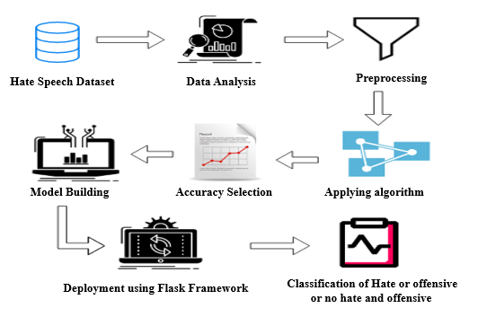
ARCHITECTURE / METHODOLOGY USED
SYSTEM ARCHITECTURE:

Slide 13
ALGORITHMS USED:
RANDOM FOREST ALGORITHM
NAÏVE BAYES ALGORITHM
GRADIENT BOOSTING ALGORITHM

Slide 14
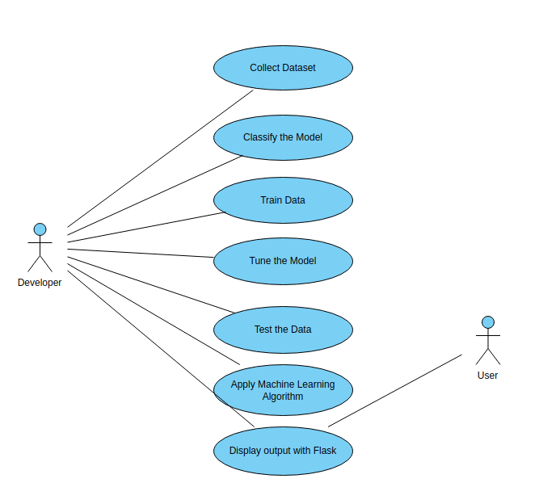
SYSTEM DESIGN
USECASE DIAGRAM:

Slide 15
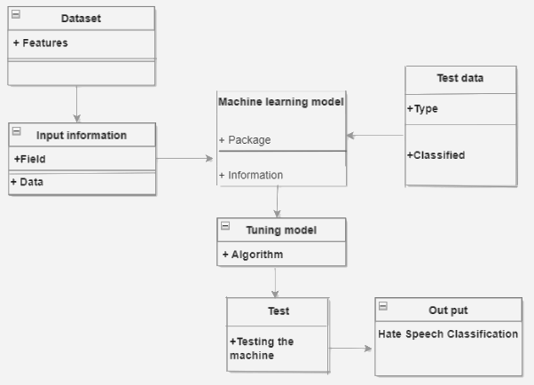
CLASS DIAGRAM:

Slide 16
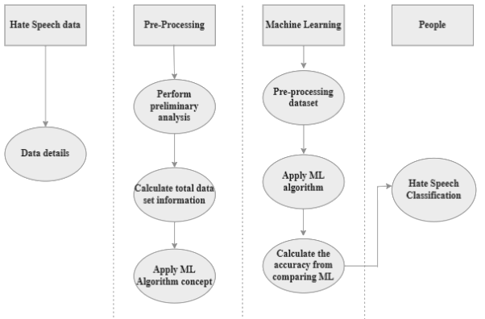
ACTIVITY DIAGRAM:

Slide 17
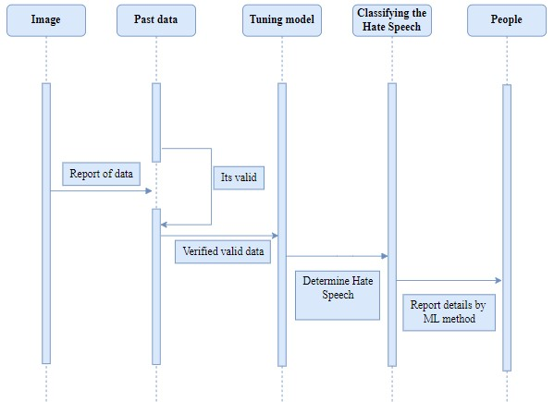
SEQUENCE DIAGRAM:

Slide 18
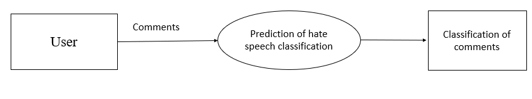
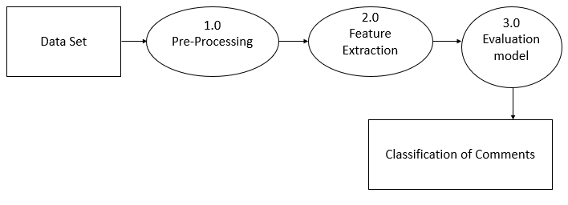
DATA FLOW DIAGRAM:
LEVEL 0 DFD:
LEVEL 1 DFD:

Slide 19
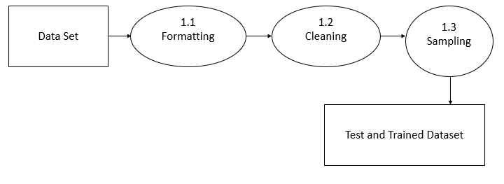
LEVEL 2 DFD:

Slide 20
MODULE DESCRIPTION DATA PRE-PROCESSING:
Pre-processing refers to the transformations applied to our data before feeding it to the algorithm. Data Pre processing is a technique that is used to convert the raw data into a clean data set. In other words, whenever the data is gathered from different sources it is collected in raw format which is not feasible for the analysis. To achieving better results from the applied model in Machine Learning method of the data has to be in a proper manner. Some specified Machine Learning model needs information in a specified format, for example, Random Forest algorithm does not support null values. Therefore, to execute random forest algorithm null values have to be managed from the original raw data set. And another aspect is that data set should be formatted in such a way that more than one Machine Learning and Deep Learning algorithms are executed in given dataset.

Slide 21
DATA VALIDATION/CLEANING/PREPARING PROCESS:
Data validation is the process of verifying and validating data that is collected before it is used.So it means checking the accuracy and quality of source data before using,importing or otherwise processing data.The primary goal of data cleaning is to detect and remove errors and anomalies to increase the value of data in analytics and decision making. Data cleaning is the process of fixing or removing incorrect, corrupted, incorrectly formatted, duplicate, or incomplete data within a dataset.

Slide 22
MACHINE LEARNING MODEL DEVELOPMENT:
It is crucial to reliably compare the performance of various machine learning algorithms, and it will become clear that scikit-learn in Python can be used to build a test harness for this purpose. You can apply this test harness as a model for your own machine learning issues and include additional and various methods to contrast. There will be variations in the efficiency attributes of each model. You can assess each model's potential accuracy on unobserved data by using resampling techniques like cross validation. It must be able to select one or two of the best models from the group of models you have developed using these approximations. It is a good idea to visualize new datasets using a variety of methods in order to view the data from various angles. The choice of models follows the same logic. In order to select the one or two that will be used for finalization, you should examine the expected accuracy of your machine learning algorithms in a variety of ways. Using various visualization techniques to display the average accuracy, variance, and other characteristics of the range of model accuracies is one way to achieve this.

Slide 23
RANDOM FOREST ALGORITHM :
Random Forest is a popular machine learning algorithm that belongs to the supervised learning technique. It can be used for both Classification and Regression problems in ML. It is based on the concept of ensemble learning, which is a process of combining multiple classifiers to solve a complex problem and to improve the performance of the model. As the name suggests, "Random Forest is a classifier that contains a number of decision trees on various subsets of the given dataset and takes the average to improve the predictive accuracy of that dataset." Instead of relying on one decision tree, the random forest takes the prediction from each tree and based on the majority votes of predictions, and it predicts the final output.

Slide 24
NAIVE BAYES ALGORITHM:
The Naive Bayes algorithm is an intuitive method that uses the probabilities of each attribute belonging to each class to make a prediction. It is the supervised learning approach you would come up with if you wanted to model a predictive modeling problem probabilistically Naive bayes simplifies the calculation of probabilities by assuming that the probability of each attribute belonging to a given class value is independent of all other attributes. This is a strong assumption but results in a fast and effective method . Naive Bayes is a statistical classification technique based on Bayes Theorem. It is one of the simplest supervised learning algorithms .Naive Bayes classifier is the fast, accurate and reliable algorithm. Naive Bayes classifiers have high accuracy and speed on large datasets.

Slide 25
GRADIENT BOOSTING:
Boosting is one of the popular learning ensemble modeling techniques used to build strong classifiers from various weak classifiers. It starts with building a primary model from available training data sets then it identifies the errors present in the base model. After identifying the error, a secondary model is built, and further, a third model is introduced in this process. In this way, this process of introducing more models is continued until we get a complete training data set by which model predicts correctly. AdaBoost (Adaptive boosting) was the first boosting algorithm to combine various weak classifiers into a single strong classifier in the history of machine learning. It primarily focuses to solve classification tasks such as binary classification. there are so many algorithms used in machine learning, boosting algorithms has become mainstream in the machine learning community across the world.

Slide 26
DEPLOYMENT USING FLASK:
Flask is a micro web framework written in Python.It is classified as a micro-framework because it does not require particular tools or libraries.It has no database abstraction layer, form validation, or any other components where pre-existing third-party libraries provide common functions.However, flask supports extensions that can add application features as if they were implemented in flask itself. Extensions exist for object-relational mappers, form validation, upload handling, various open authentication technologies and several common framework related tools.The most accurate algorithm is used to implement the model Gradient Boosting, one of three algorithms, is the strongest model. The Flask micro web framework is used to deploy this model.

Slide 27
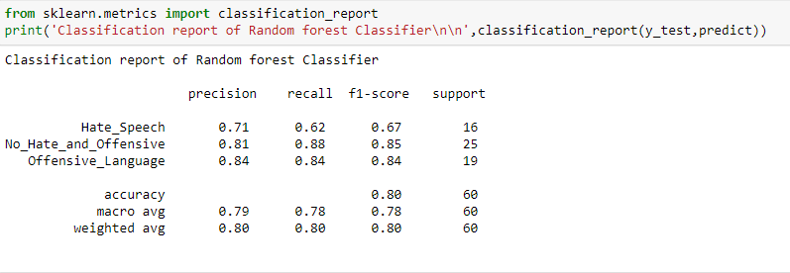
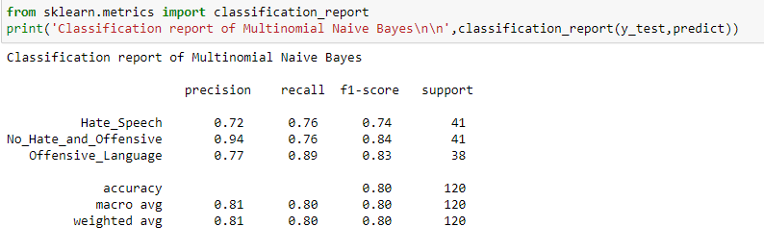
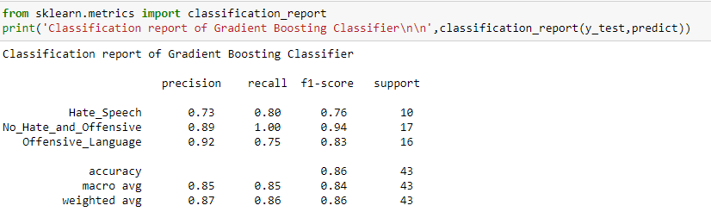
PERFORMANCE EVALUATION
CLASSIFICATION REPORT:

Slide 28
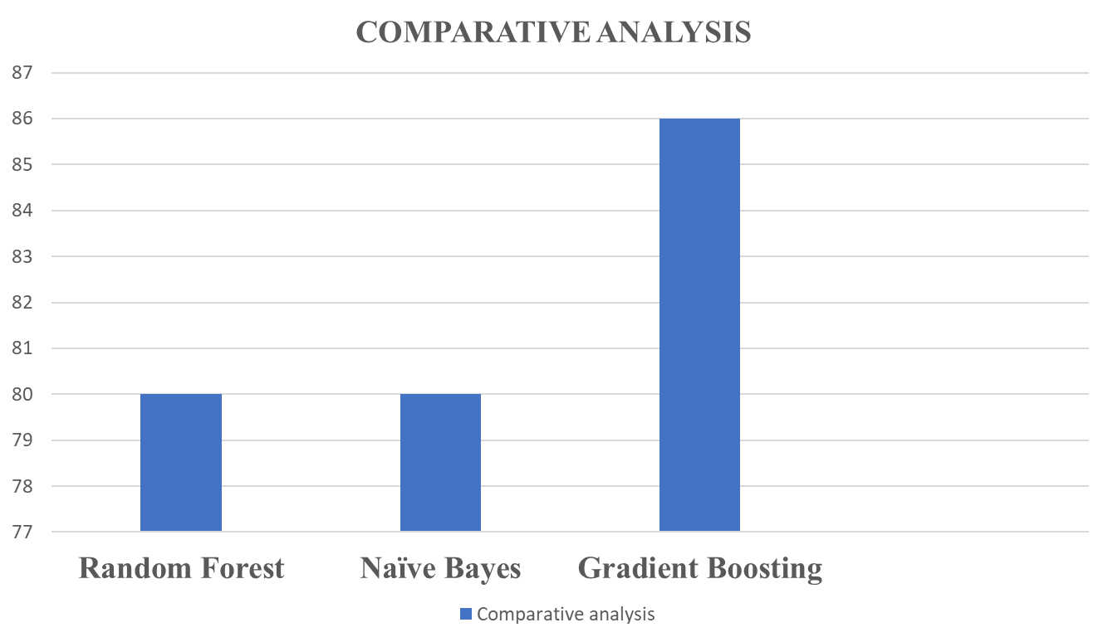
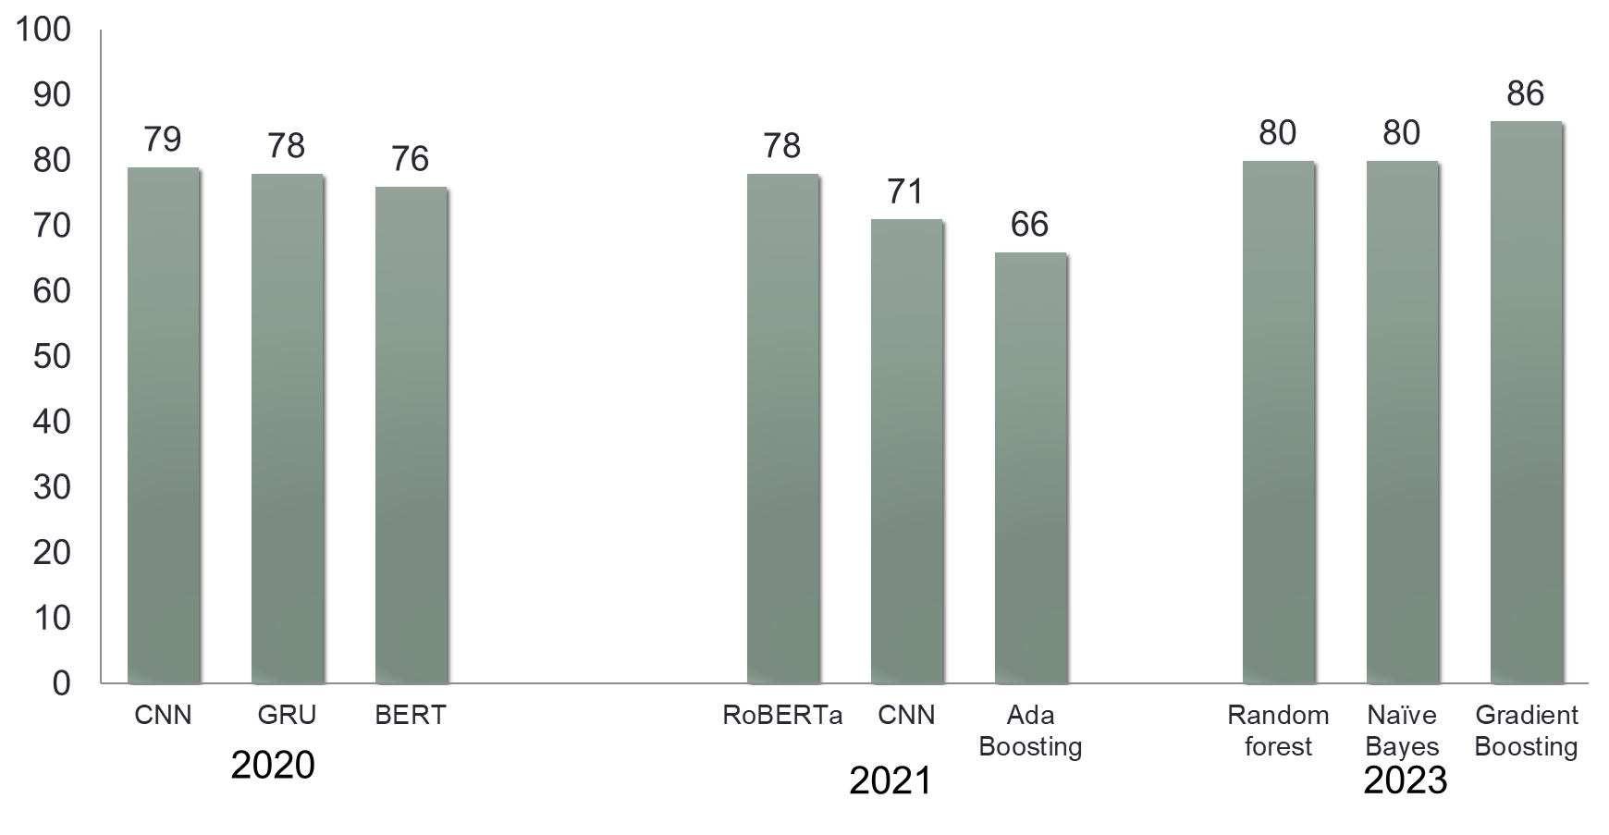
ACCURACY COMPARISON:

Slide 29
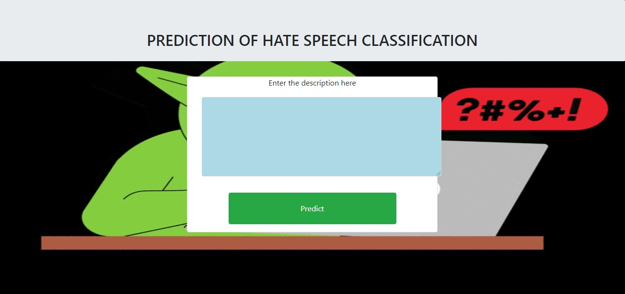
SCREENSHOTS

Slide 30
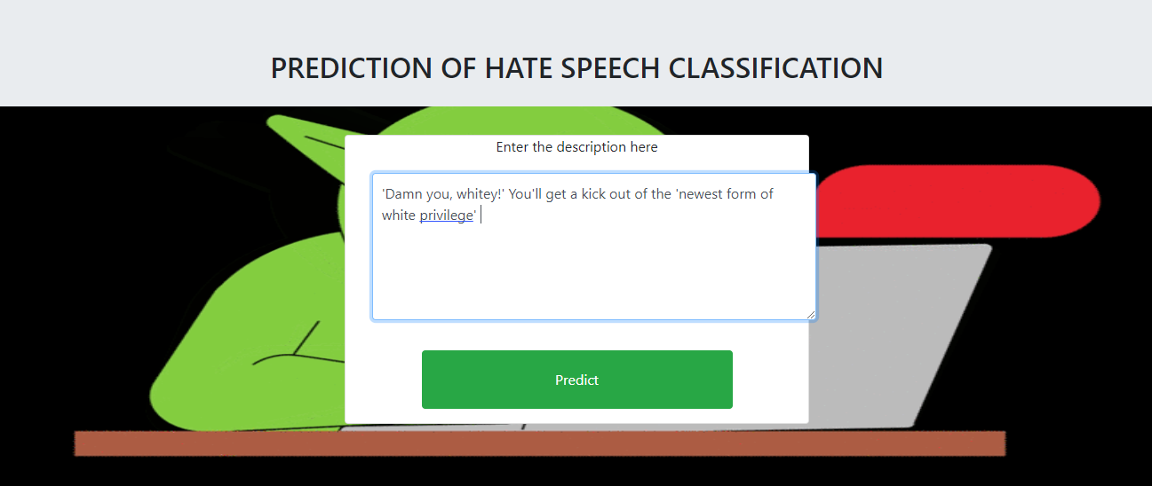
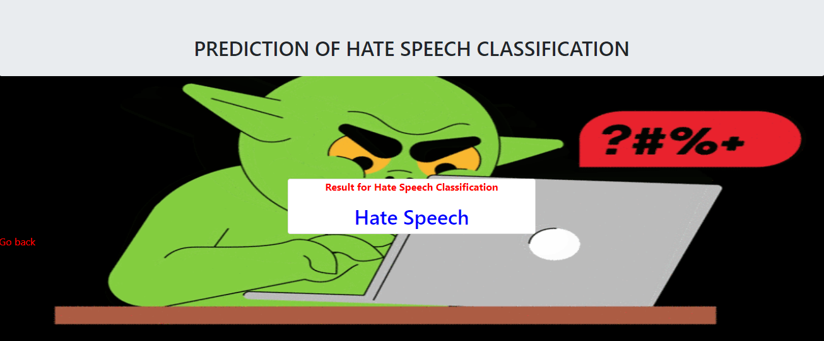
HATE SPEECH

Slide 31
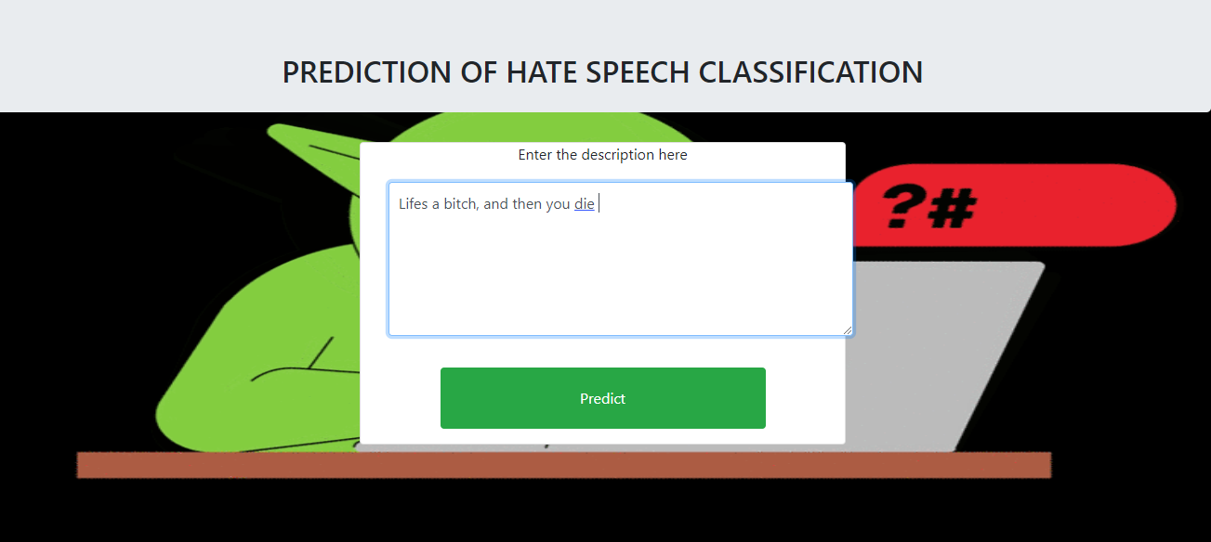
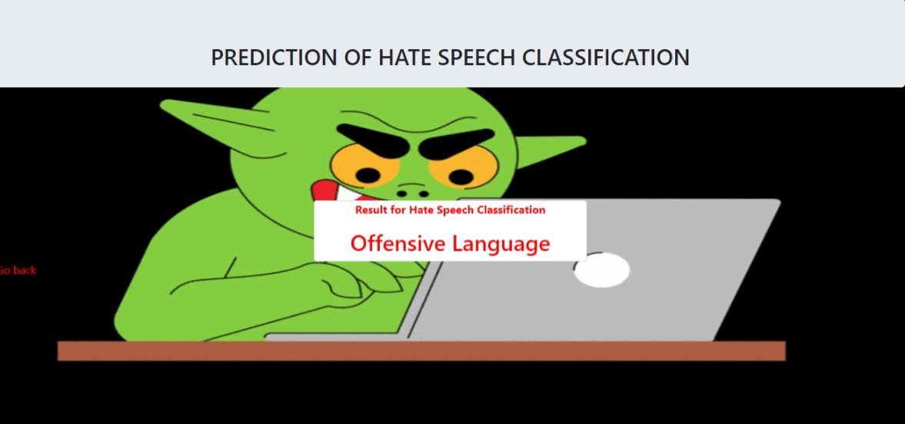
OFFENSIVE LANGUAGE

Slide 32
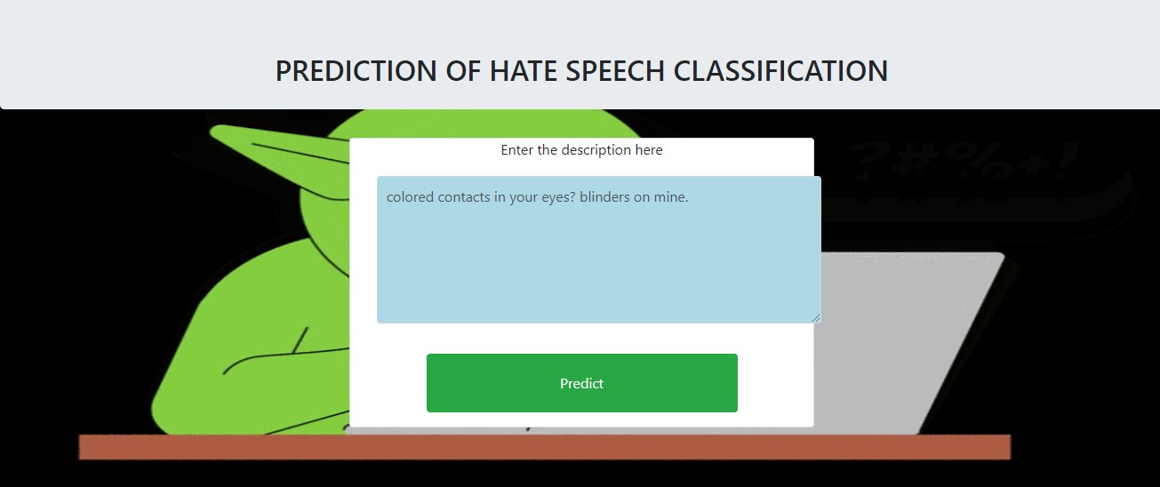
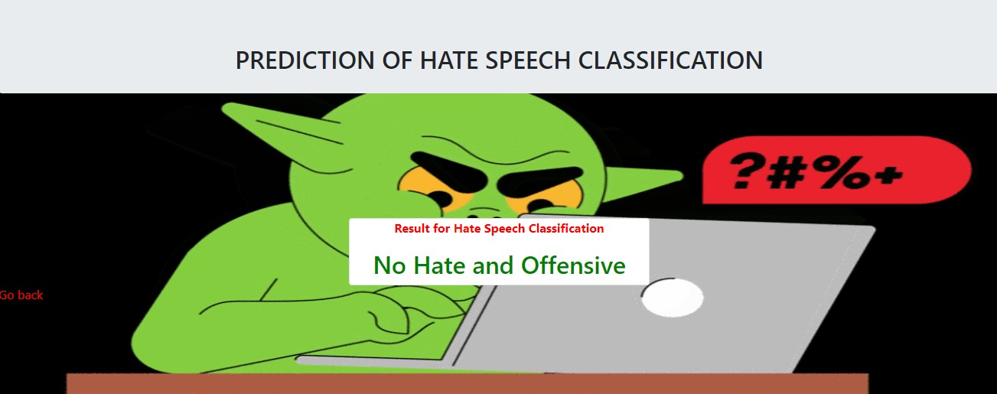
NO HATE AND OFFENSIVE

Slide 33
CONCLUSION AND FUTURE ENHANCEMENTS
As the world moves more and more toward digital technology, everyone now has access to the internet and can publish whatever they want, making the control of hate speech very difficult. Therefore, there is a higher likelihood that individuals will be misled. Machine learning is typically designed to handle these types of complex tasks because it requires more time to manually analyze these types of data. By using previous data, making them comprehend patterns, and improving the accuracy of the model by changing parameters, machine learning can be used to classify speech as hate speech or not. The model is then used as the classification model. The optimal model can be used for classification by comparing various algorithms. The Gradient Boosting algorithm is determined to provide the best accuracy of the three algorithms. As a result, the project's implementation used the Gradient boosting algorithm. The analytical process started from data cleaning and processing, missing value, exploratory analysis and finally model building and evaluation. The best accuracy on public test set is higher accuracy score will be found and the application helps to find the Prediction of hate speech.

Slide 34
REFERENCES
[1] Soumitra Ghosh , Asif Ekbal , Pushpak Bhattacharyya, Tista Saha, Alka Kumar, and Shikha Srivastava,”SEHC: A Benchmark Setup to Identify Online Hate Speech in English” in IEEE Transactions on Computational Social Systems, 2022
[2] Zewdie Mossie, Jenq-Haur Wang,”Vulnerable community identification using hate speech detection on social media” in Information Processing & Management 57 (3), 102087, 2020
[3] Binny Mathew, Punyajoy Saha, Seid Muhie Yimam, Chris Biemann, Pawan Goyal, Animesh Mukherjee,” HateXplain “A Benchmark Dataset for Explainable Hate Speech Detection” in Proceedings of the AAAI Conference on Artificial Intelligence 35 (17), 14867-14875, 2021
[4]Kovács Pedro Alonso Rajkumar Saini,” Challenges of Hate Speech Detection in Social Media” in SN Computer Science 2, 1-15, 2021
[5] Amrutha, B R and Bindu, K R, “Detecting Hate Speech in Tweets Using Different Deep Neural Network Architectures in 2019 International Conference on Intelligent Computing and Control Systems (ICCS), 923-926, 2019
[6] Sindhu Abro1 , Sarang Shaikh2 , Zafar Ali ,” Automatic Hate Speech Detection using Machine Learning: A Comparative Study”in International Journal of Advanced Computer Science and Applications 11 (8), 2020

Slide 35
[7] Raghad Alshalan and Hend Al-Khalifa,” A Deep Learning Approach for Automatic Hate Speech Detection in the Saudi Twittersphere”in Applied Sciences 10 (23), 8614, 2020
[8] Varsha Pathak , Manish Joshi , Prasad A. Joshi , Monica Mundada , Tanmay Joshi,” Using Machine Learning for Detection of Hate Speech and Offensive Code-Mixed Social Media text “ in arXiv preprint arXiv:2102.09866, 2021
[9] Ching Seh Wu, Unnathi Bhandary,” Detection of Hate Speech in Videos Using Machine Learning” in 2020 International Conference on Computational Science and Computational Intelligence (CSCI), 585-590, 2020
[10] Georgios Rizos, Konstantin Hemker, Bjorn Schuller,” Augment to Prevent: Short-Text Data Augmentation in Deep Learning for Hate-Speech Classification” in Proceedings of the 28th ACM international conference on information and knowledge management, 991-1000, 2019
[11] Hajime Watanabe, Mondher Bouazizi, Tomoaki Ohtsuki ,” Hate Speech on Twitter: A Pragmatic Approach to Collect Hateful and Offensive Expressions and Perform Hate Speech Detection”in IEEE access 6, 13825-13835, 2018
[12] Thomas Davidson,Dana Warmsle,Michael Macy, Ingmar Weber,” Automated Hate Speech Detection and the Problem of Offensive Language” in Proceedings of the international AAAI conference on web and social media 11 (1), 512-515, 2017

